Slide 1

The Machine Learning Process
using a decision tree model
Part 02
Reza Dibaj

Slide 2

Visualizing a Decision Tree
Today we are going to add code to visualize Decision Tree, and see how it works under the hood.
“Orange”
Notes:
In the previous presentation, we used a decision tree as our classifier. Today we will add code to visualize it, so we can see how it works under the hood.

Slide 3
Contents
Types of classifiers
A Classic Machine Learning Problem
Defining a Hands on Project
More to Learn
Conclusion

Slide 4
Types of classifiers
There are number of classifiers in Machine Learning:
Artificial Neural Network (ANN)
Support Vector Machine (SVM)
Decision Tree

Slide 5
Types of classifiers
Why did we use Decision Tree to start?
Easy to read and understand
One of the few models that are interpretable
Notes:
One of the few models that are interpretable where you can understand exactly why the classifier makes a decision. That is amazingly useful in practice.

Slide 6
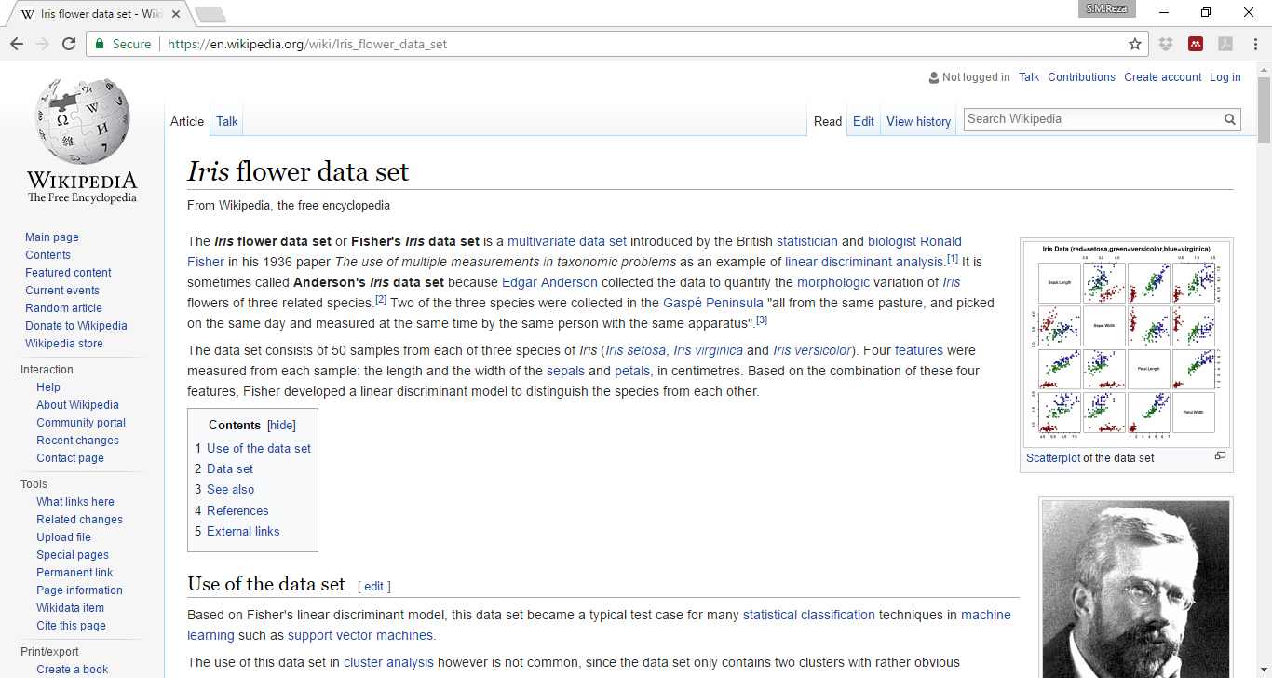
A Classic Machine Learning Problem
Working with Iris flower data set:
https://en.wikipedia.org/wiki/Iris_flower_data_set

Slide 7
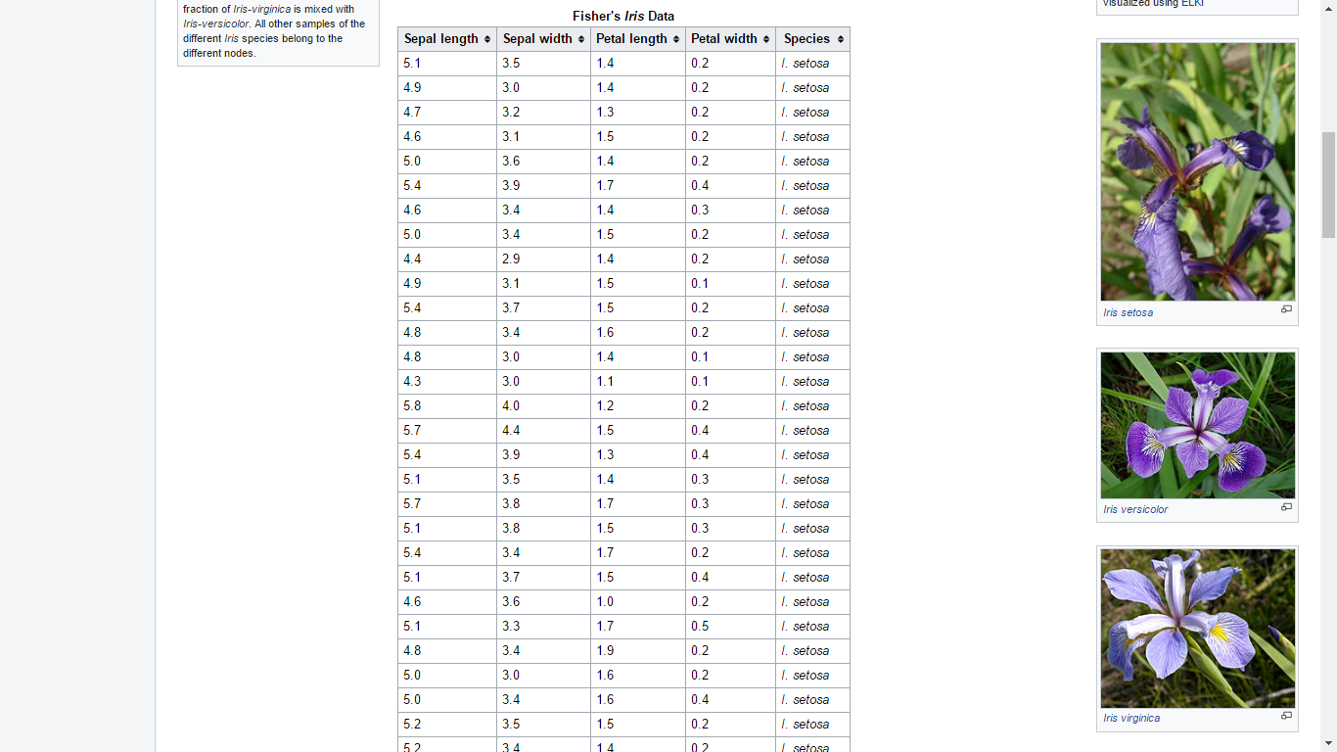
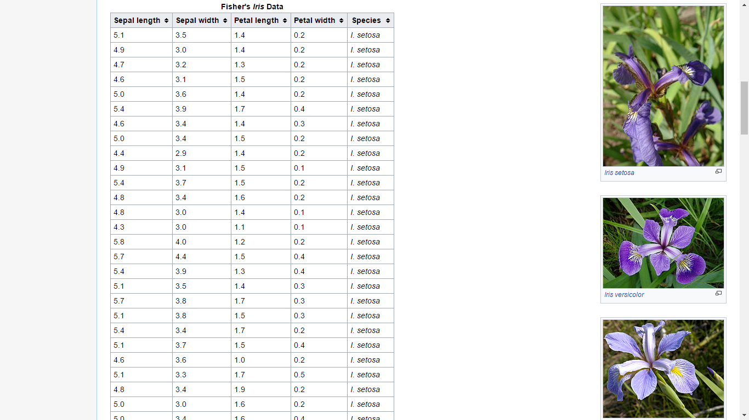
A Classic Machine Learning Problem
Working with Iris flower data set:
https://en.wikipedia.org/wiki/Iris_flower_data_set
Features
Label

Slide 8
Defining a Hands on Project
Goals
Import dataset
Train a classifier
Predict label for new flower(s)
Visualize the tree

Slide 9
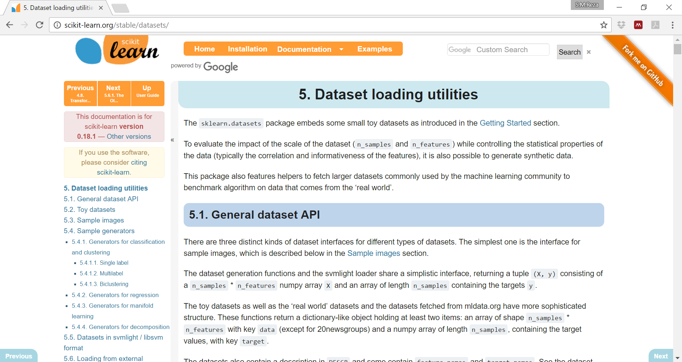
Defining a Hands on Project
Knowing how to work with an existing data set:
http://scikit-learn.org/stable/datasets/

Slide 10
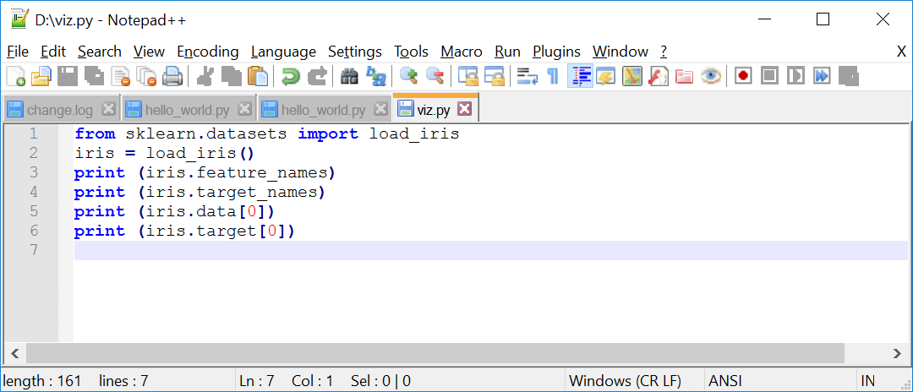
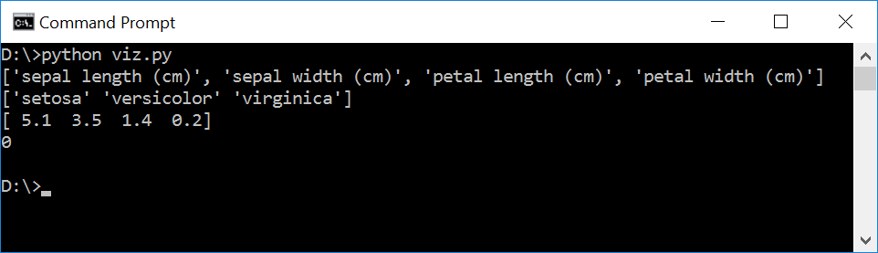
Defining a Hands on Project
Knowing how to work with an existing data set:
Notes:
from sklearn.datasets import load_iris
iris = load_iris()
print (iris.feature_names)
print (iris.target_names)
print (iris.data[0])
print (iris.target[0])

Slide 11
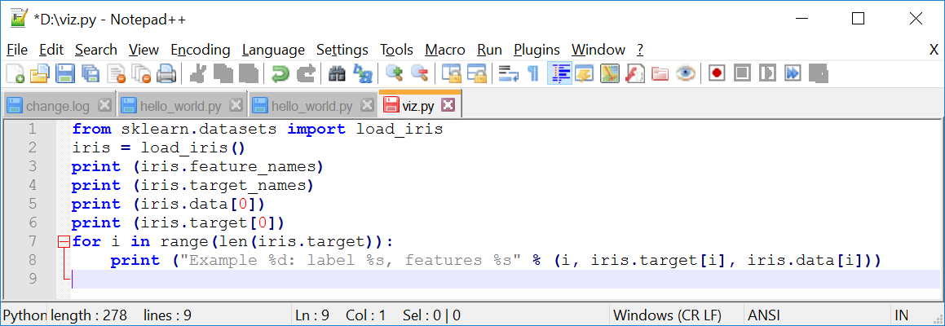
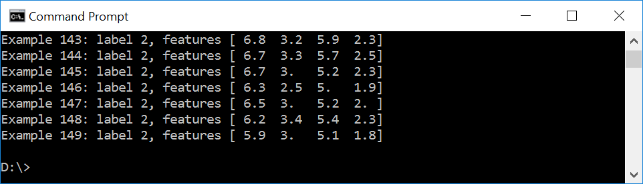
Defining a Hands on Project
Knowing how to work with an existing data set:
Notes:
from sklearn.datasets import load_iris
iris = load_iris()
print (iris.feature_names)
print (iris.target_names)
print (iris.data[0])
print (iris.target[0])
for i in range(len(iris.target)):
print ("Example %d: label %s, features %s" % (i, iris.target[i], iris.data[i]))

Slide 12

Defining a Hands on Project
Goals
Import dataset
Train a classifier
Predict label for new flower(s)
Visualize the tree
Notes:
Now we are ready to train the classifier, but before we do that we need to split up the data

Slide 13
Defining a Hands on Project
Testing Data
Examples used to “test” the classifier’s accuracy
Not part of the training data
Just like in programming, testing is a very important part of ML

Slide 14
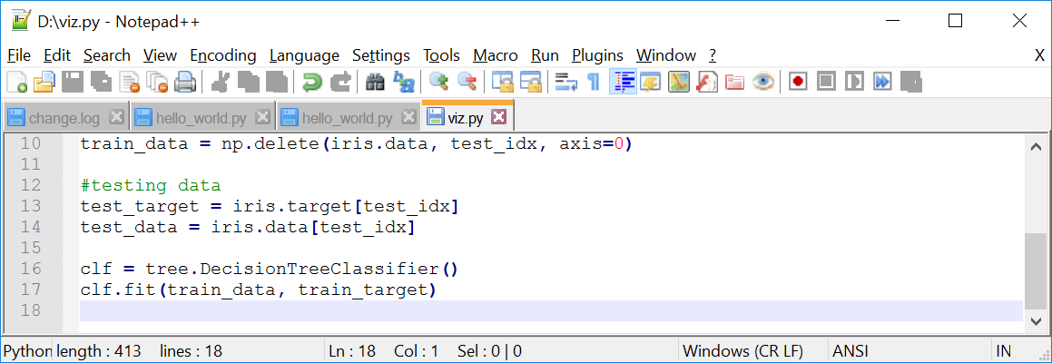
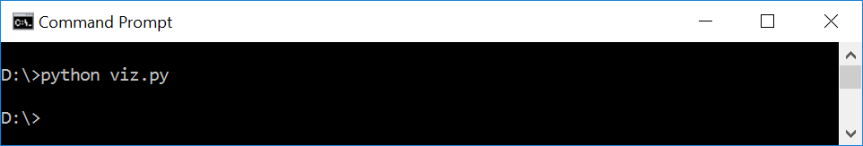
Defining a Hands on Project
Knowing how to work with an existing data set:
Notes:
import numpy as np
from sklearn.datasets import load_iris
from sklearn import tree
iris = load_iris()
test_idx = [0,50,100]
#training data
train_target = np.delete(iris.target, test_idx)
train_data = np.delete(iris.data, test_idx, axis=0)
#testing data
test_target = iris.target[test_idx]
test_data = iris.data[test_idx]
clf = tree.DecisionTreeClassifier()
clf.fit(train_data, train_target)

Slide 15
Defining a Hands on Project
Goals
Import dataset
Train a classifier
Predict label for new flower(s)
Visualize the tree

Slide 16
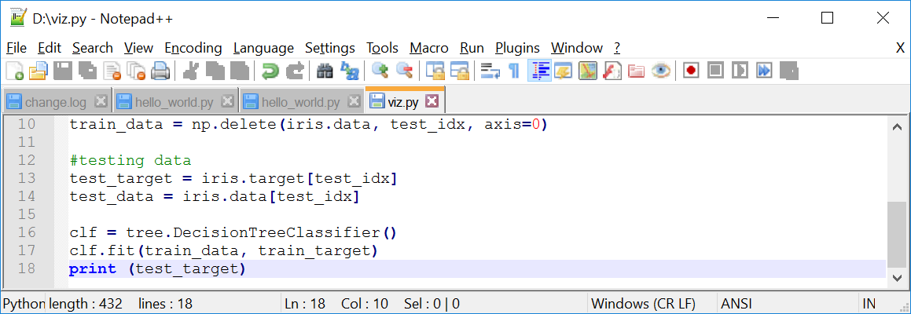
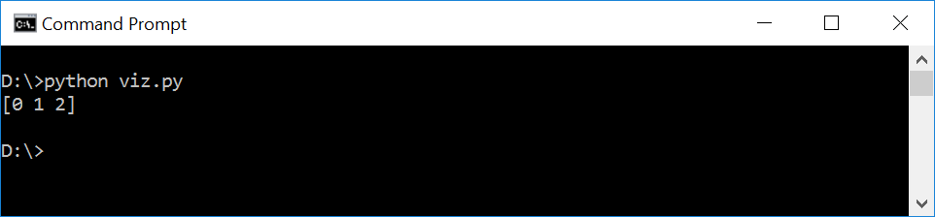
Defining a Hands on Project
Knowing how to work with an existing data set:
Notes:
import numpy as np
from sklearn.datasets import load_iris
from sklearn import tree
iris = load_iris()
test_idx = [0,50,100]
#training data
train_target = np.delete(iris.target, test_idx)
train_data = np.delete(iris.data, test_idx, axis=0)
#testing data
test_target = iris.target[test_idx]
test_data = iris.data[test_idx]
clf = tree.DecisionTreeClassifier()
clf.fit(train_data, train_target)
print (test_target)

Slide 17
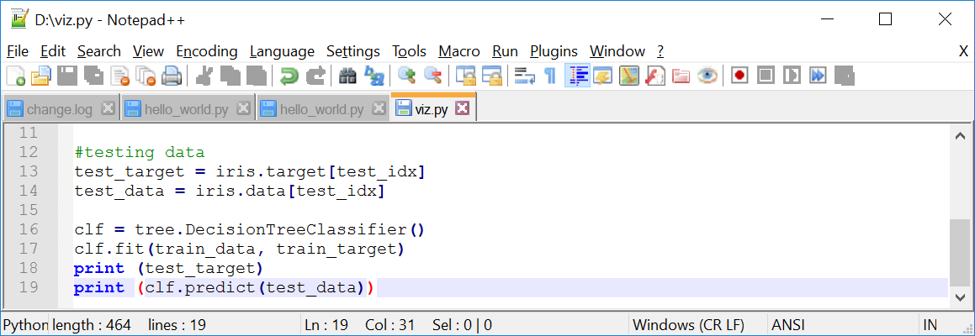
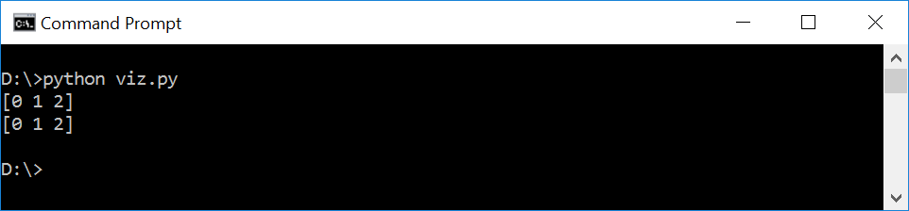
Defining a Hands on Project
Knowing how to work with an existing data set:
Notes:
import numpy as np
from sklearn.datasets import load_iris
from sklearn import tree
iris = load_iris()
test_idx = [0,50,100]
#training data
train_target = np.delete(iris.target, test_idx)
train_data = np.delete(iris.data, test_idx, axis=0)
#testing data
test_target = iris.target[test_idx]
test_data = iris.data[test_idx]
clf = tree.DecisionTreeClassifier()
clf.fit(train_data, train_target)
print (test_target)
print (clf.predict(test_data))

Slide 18
Defining a Hands on Project
Goals
Import dataset
Train a classifier
Predict label for new flower(s)
Visualize the tree

Slide 19
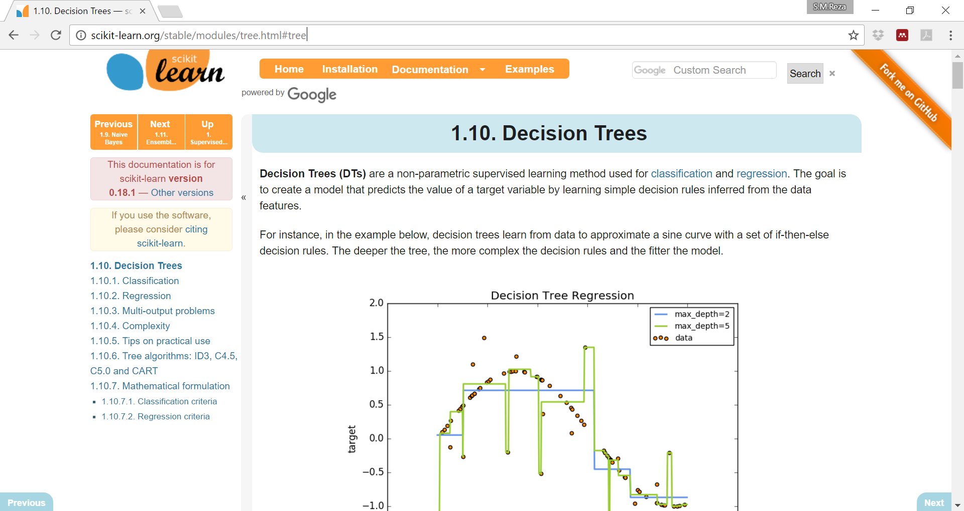
Defining a Hands on Project
Knowing how to work with an existing data set:
http://scikit-learn.org/stable/modules/tree.html#tree

Slide 20
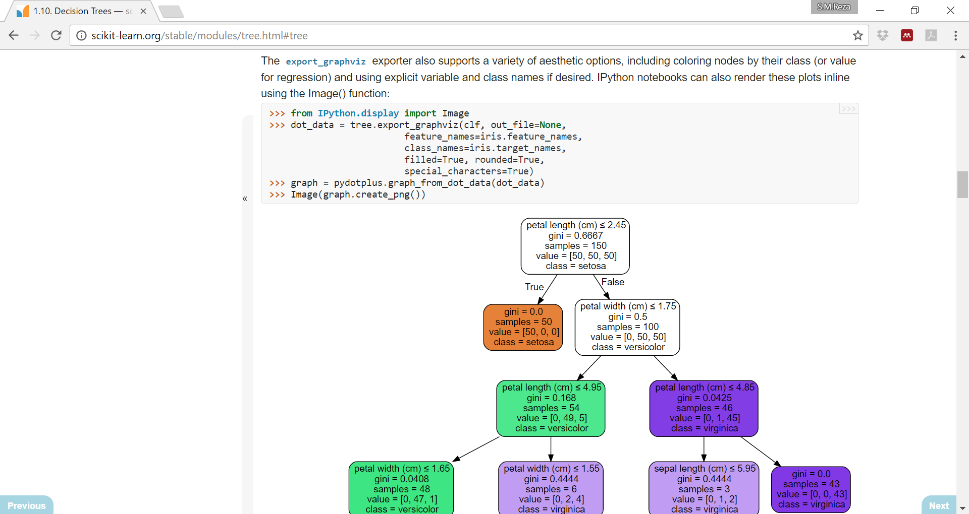
Defining a Hands on Project
Knowing how to work with an existing data set:
http://scikit-learn.org/stable/modules/tree.html#tree
Notes:
import numpy as np
from sklearn.datasets import load_iris
from sklearn import tree
iris = load_iris()
test_idx = [0,50,100]
#training data
train_target = np.delete(iris.target, test_idx)
train_data = np.delete(iris.data, test_idx, axis=0)
#testing data
test_target = iris.target[test_idx]
test_data = iris.data[test_idx]
clf = tree.DecisionTreeClassifier()
clf.fit(train_data, train_target)
print (test_target)
print (clf.predict(test_data))
#viz code
import pydotplus
from IPython.display import Image
dot_data = tree.export_graphviz(clf, out_file=None,
feature_names=iris.feature_names,
class_names=iris.target_names,
filled=True, rounded=True,
special_characters=True)
graph = pydotplus.graph_from_dot_data(dot_data)
Image(graph.create_png())

Slide 21
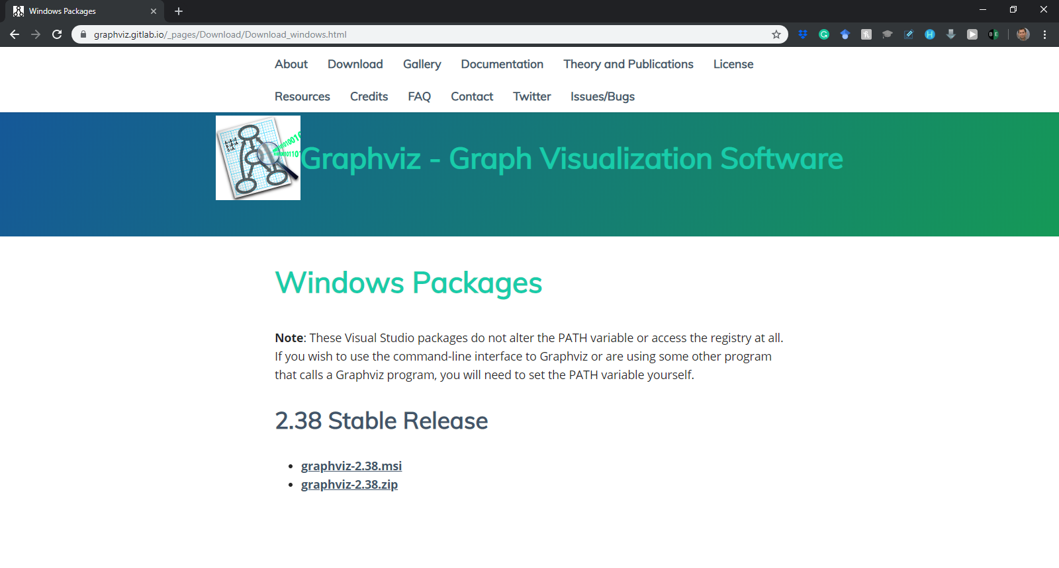
Defining a Hands on Project
IMPORTANT: (Pre-requisites)
Step 1: Installing Graphviz - Graph Visualization Software
https://graphviz.gitlab.io/_pages/Download/Download_windows.html

Slide 22
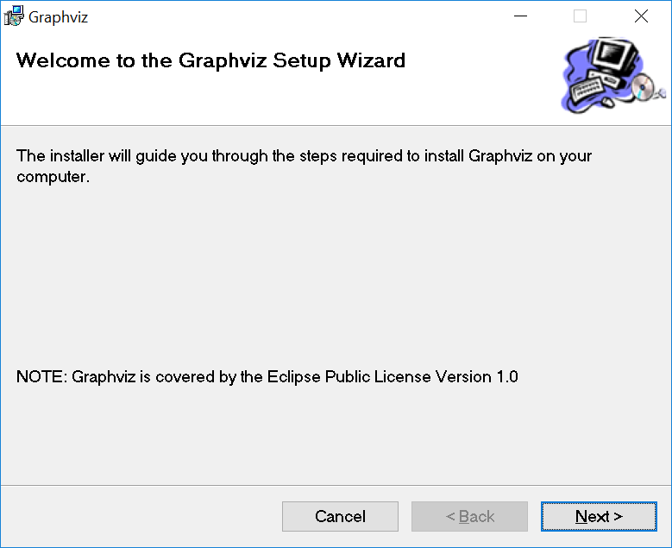
Defining a Hands on Project
IMPORTANT: (Pre-requisites)
Step 1: Installing Graphviz-Graph Visualization Software

Slide 23
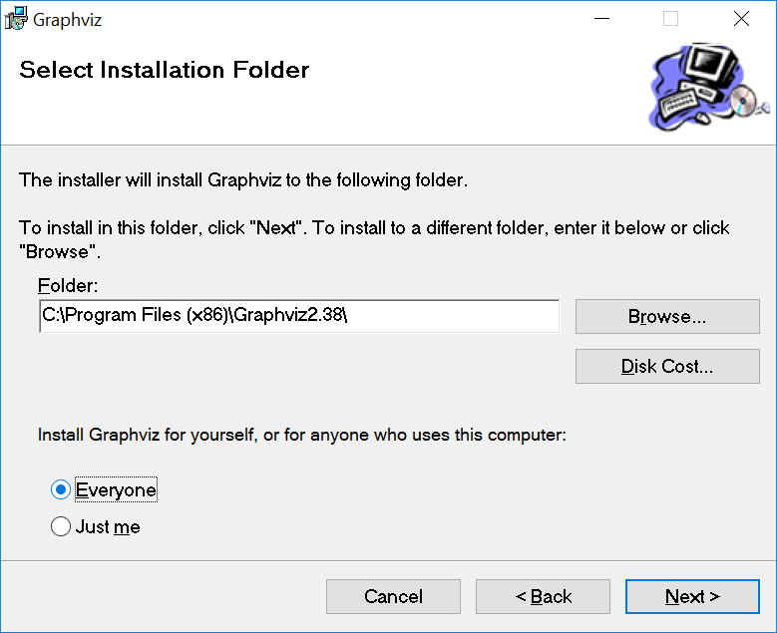
Defining a Hands on Project
IMPORTANT: (Pre-requisites)
Step 1: Installing Graphviz-Graph Visualization Software

Slide 24
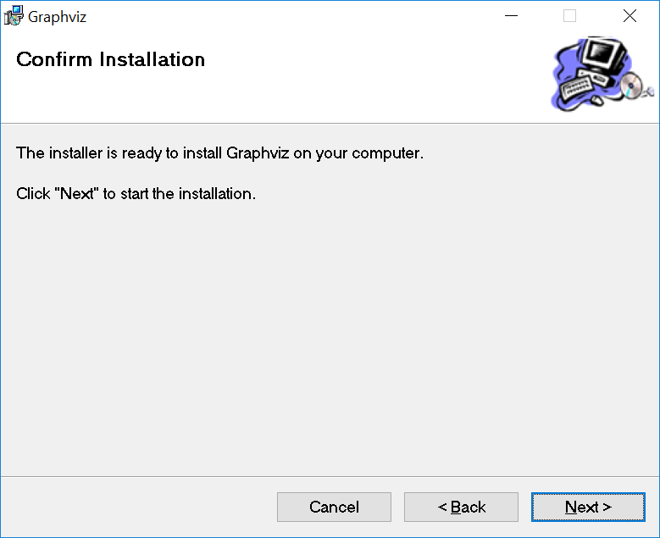
Defining a Hands on Project
IMPORTANT: (Pre-requisites)
Step 1: Installing Graphviz-Graph Visualization Software

Slide 25
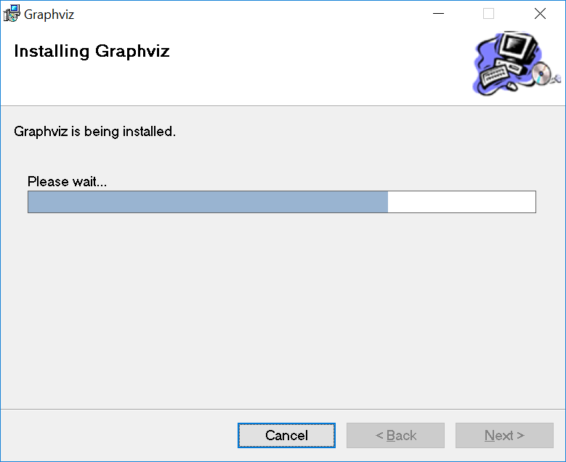
Defining a Hands on Project
IMPORTANT: (Pre-requisites)
Step 1: Installing Graphviz-Graph Visualization Software

Slide 26
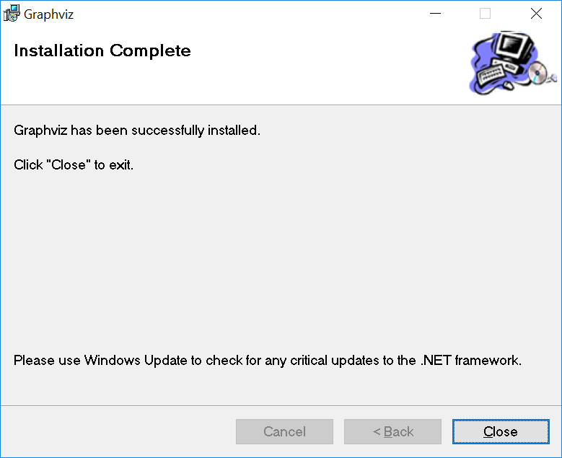
Defining a Hands on Project
IMPORTANT: (Pre-requisites)
Step 1 : Installing Graphviz-Graph Visualization Software

Slide 27
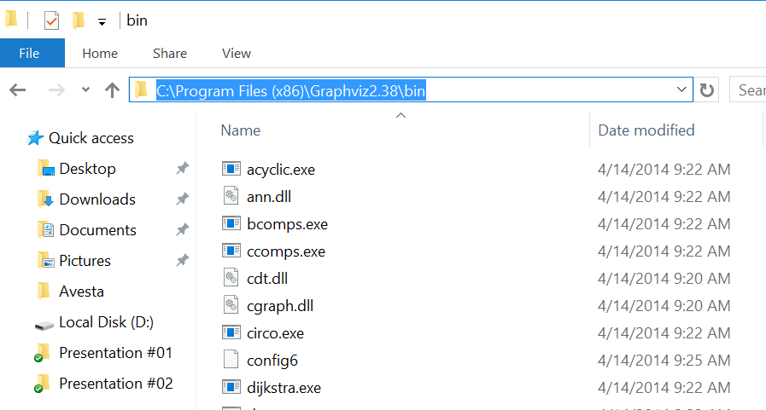
Defining a Hands on Project
IMPORTANT: (Pre-requisites)
Step 2: Copying the path that you have installed your Graphviz

Slide 28
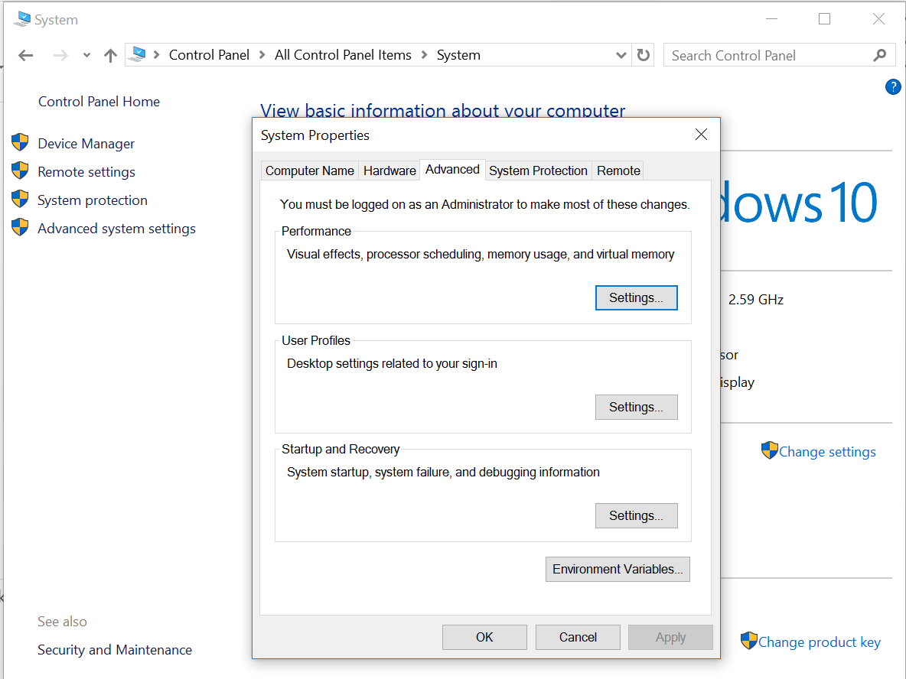
Defining a Hands on Project
IMPORTANT: (Pre-requisites)
Step 3: Changing the environment variables
1
2

Slide 29
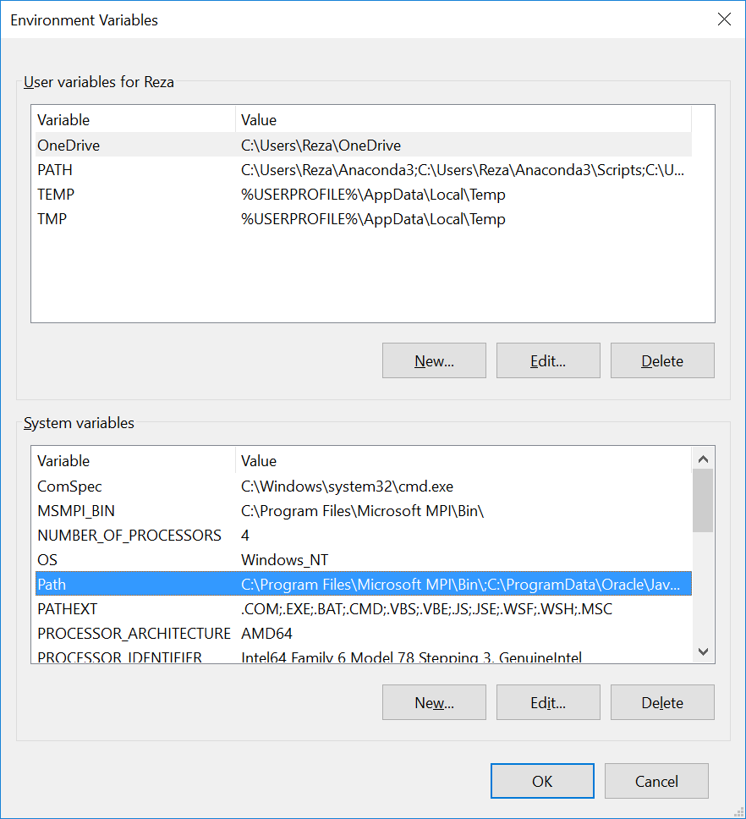
Defining a Hands on Project
IMPORTANT: (Pre-requisites)
Step 3: Changing the environment variables
1
2

Slide 30
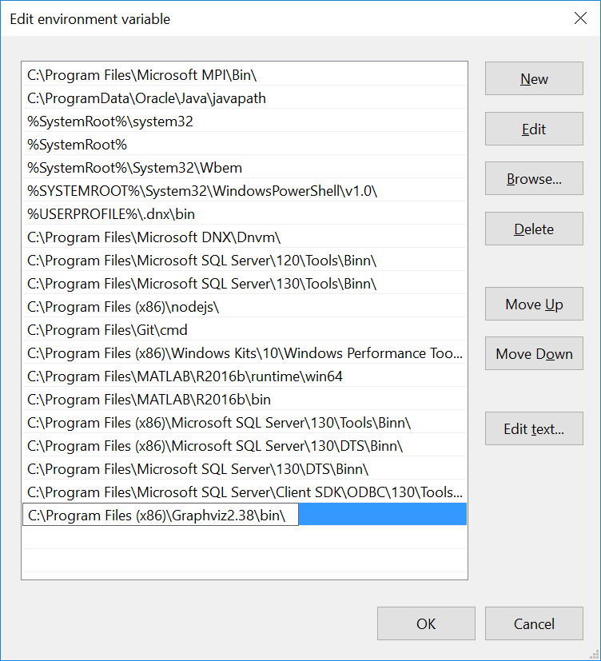
Defining a Hands on Project
IMPORTANT: (Pre-requisites)
Step 3: Changing the environment variables
1
Paste the path that you have installed your Graphviz
2
3

Slide 31
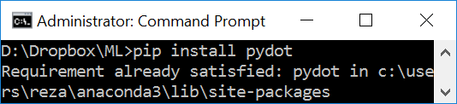
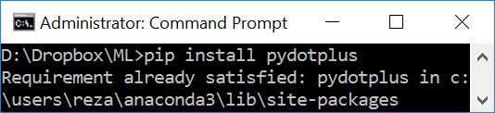
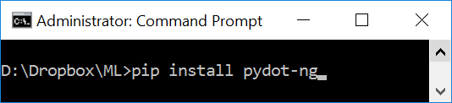
Defining a Hands on Project
IMPORTANT: (Pre-requisites)
NOTE: Please open the command prompt in administrative mode
Step 4: Install needed libraries:
>>pip install pydot
>>pip install pydotplus
>>pip install pydot-ng
Notes:
pip install pydot
pip install pydotplus
pip install pydotplus

Slide 32
Defining a Hands on Project
IMPORTANT: If for any reason you want to uninstall any of these libraries, here is how we can do it:
Uninstalling these libraries:
>>pip uninstall pydot
>>pip uninstall pydotplus
>>pip uninstall pydot-ng
Notes:
pip uninstall pydot
pip uninstall pydotplus
pip uninstall pydotplus

Slide 33
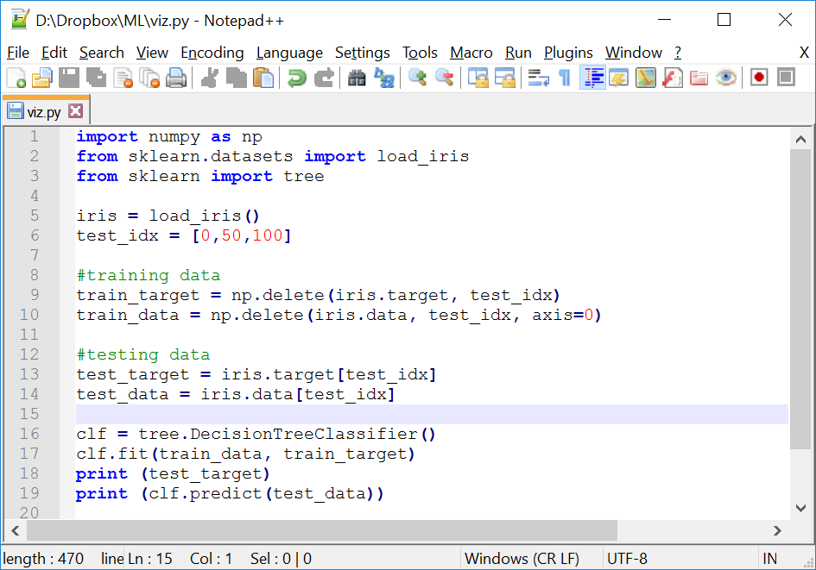
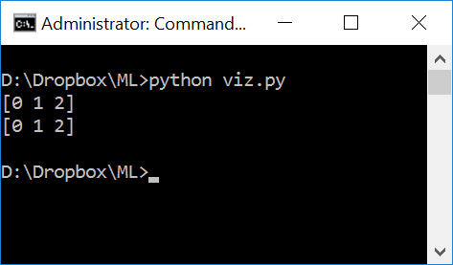
Defining a Hands on Project
Continue to program to add visualization:
Review- Where we left off
Notes:
import numpy as np
from sklearn.datasets import load_iris
from sklearn import tree
iris = load_iris()
test_idx = [0,50,100]
#training data
train_target = np.delete(iris.target, test_idx)
train_data = np.delete(iris.data, test_idx, axis=0)
#testing data
test_target = iris.target[test_idx]
test_data = iris.data[test_idx]
clf = tree.DecisionTreeClassifier()
clf.fit(train_data, train_target)
print (test_target)
print (clf.predict(test_data))

Slide 34
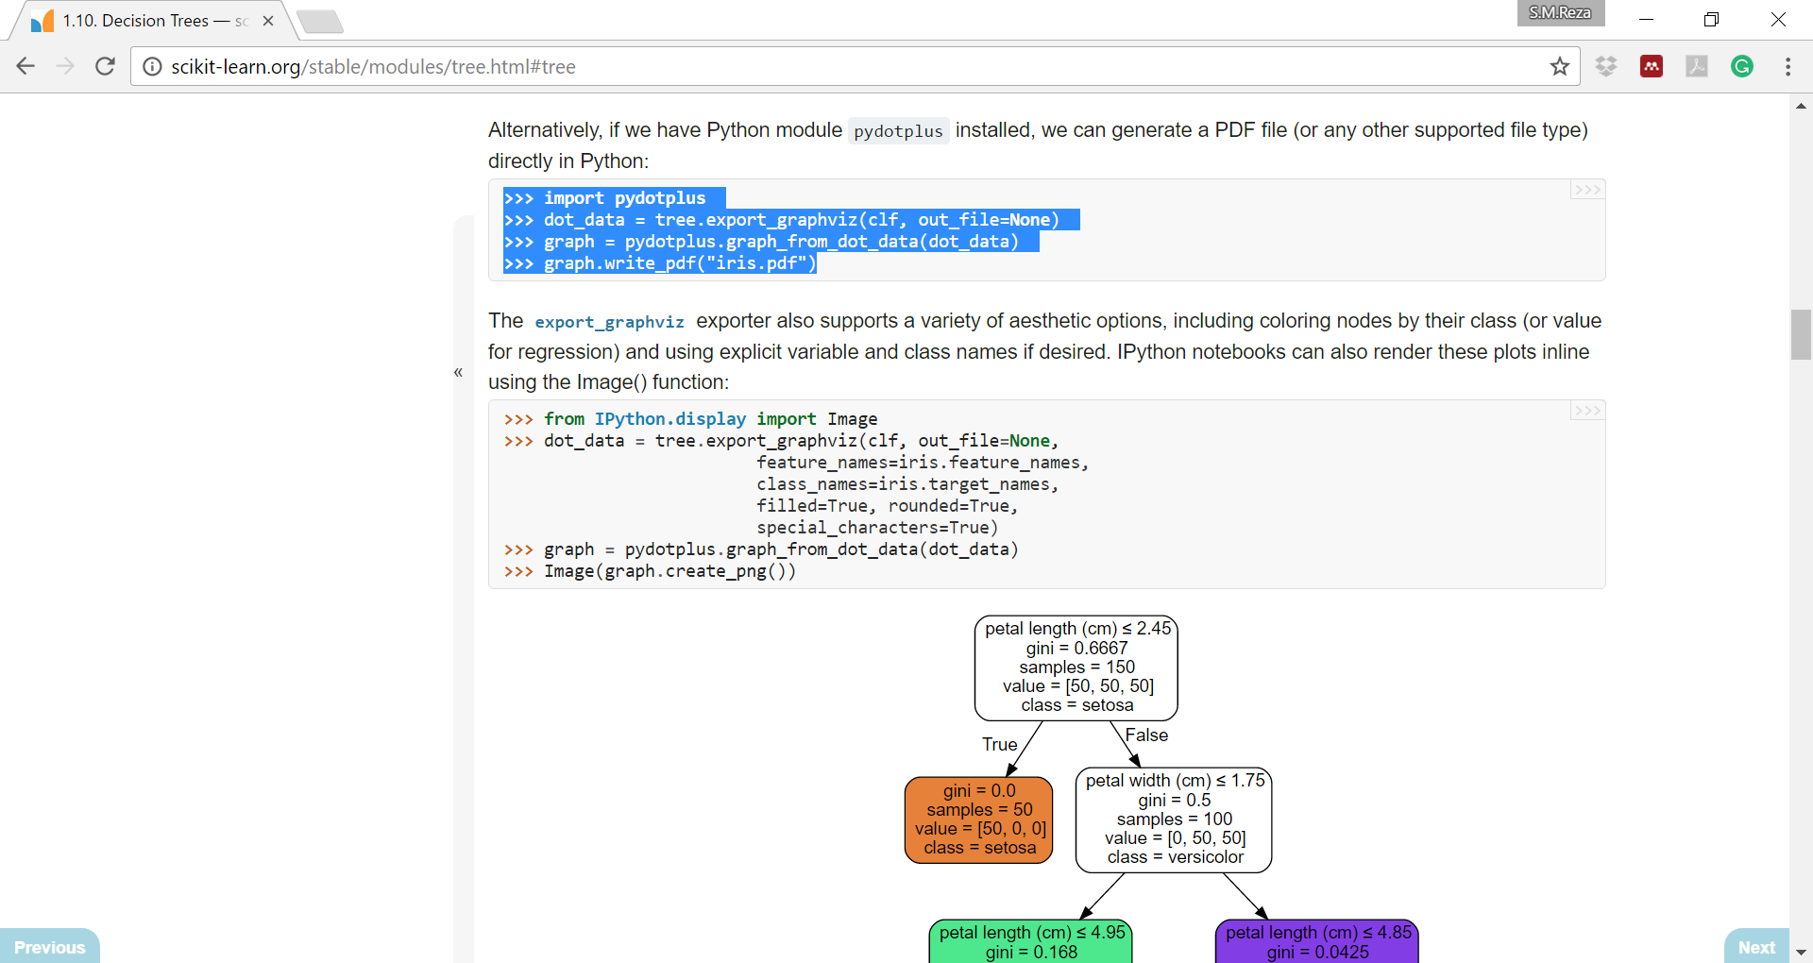
Defining a Hands on Project
Get back to this webpage and copy the following code:
http://scikit-learn.org/stable/modules/tree.html#tree

Slide 35
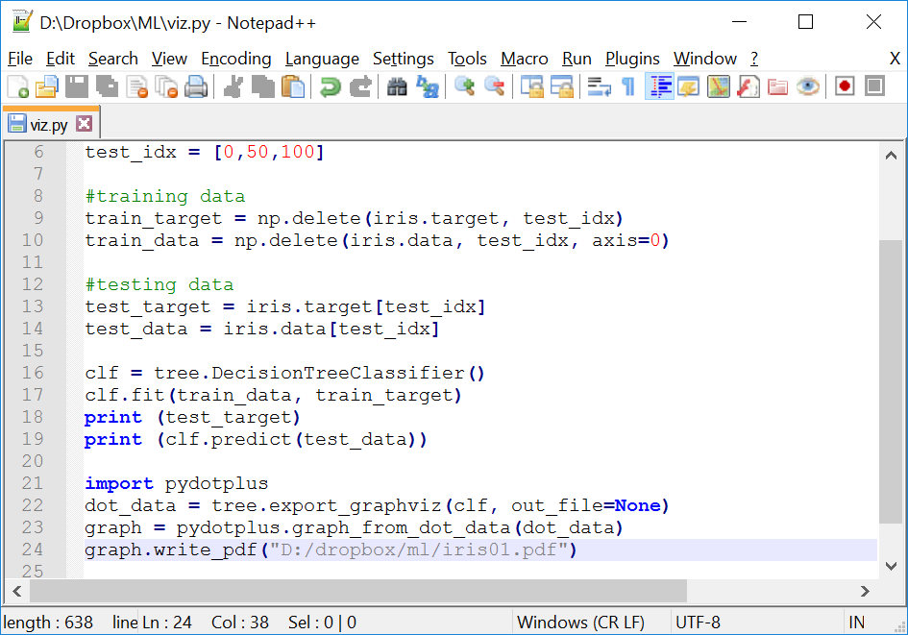
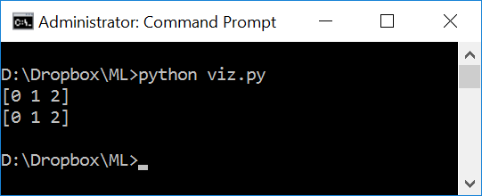
Defining a Hands on Project
Adding the copied code at the of the program:
Notes:
import numpy as np
from sklearn.datasets import load_iris
from sklearn import tree
iris = load_iris()
test_idx = [0,50,100]
#training data
train_target = np.delete(iris.target, test_idx)
train_data = np.delete(iris.data, test_idx, axis=0)
#testing data
test_target = iris.target[test_idx]
test_data = iris.data[test_idx]
clf = tree.DecisionTreeClassifier()
clf.fit(train_data, train_target)
print (test_target)
print (clf.predict(test_data))
import pydotplus
dot_data = tree.export_graphviz(clf, out_file=None)
graph = pydotplus.graph_from_dot_data(dot_data)
graph.write_pdf("D:/dropbox/ml/iris01.pdf")

Slide 36
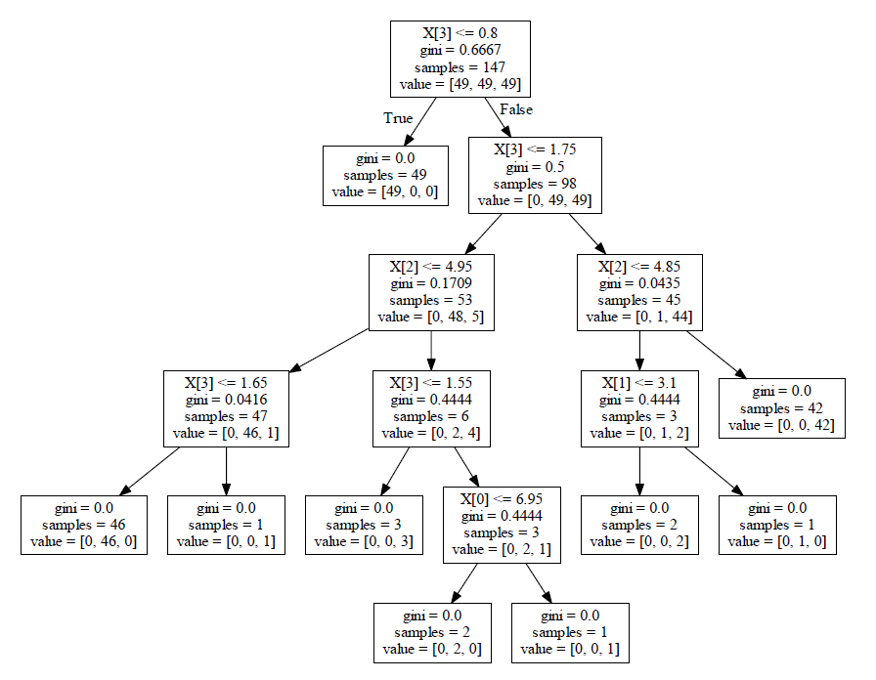
Defining a Hands on Project
The result: (PDF file)

Slide 37
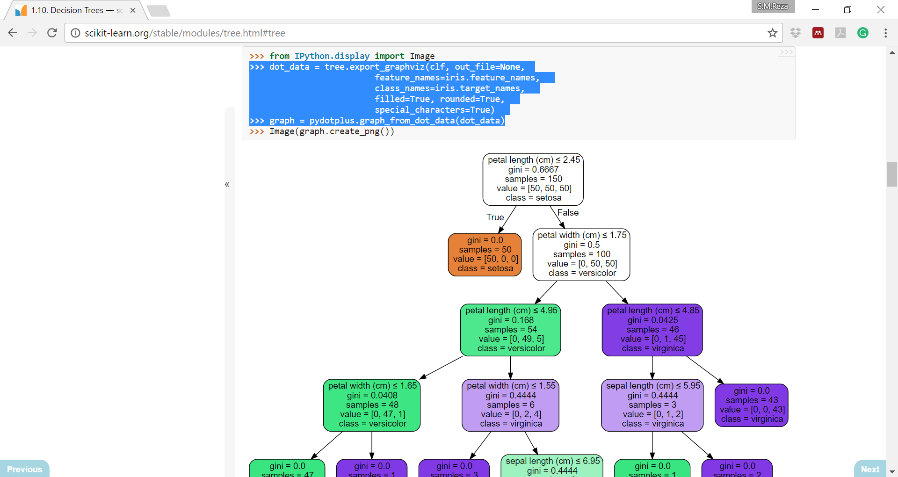
Defining a Hands on Project
Let’s add more flavor and color:
http://scikit-learn.org/stable/modules/tree.html#tree

Slide 38
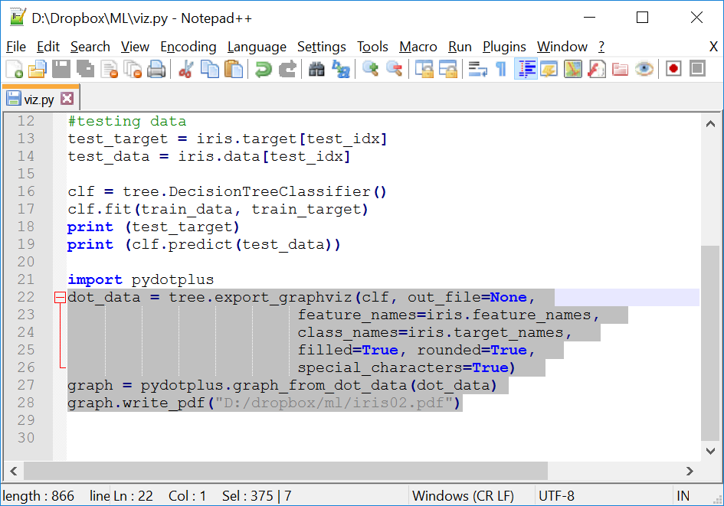
Defining a Hands on Project
Let’s add more flavor and color:
Notes:
import numpy as np
from sklearn.datasets import load_iris
from sklearn import tree
iris = load_iris()
test_idx = [0,50,100]
#training data
train_target = np.delete(iris.target, test_idx)
train_data = np.delete(iris.data, test_idx, axis=0)
#testing data
test_target = iris.target[test_idx]
test_data = iris.data[test_idx]
clf = tree.DecisionTreeClassifier()
clf.fit(train_data, train_target)
print (test_target)
print (clf.predict(test_data))
import pydotplus
dot_data = tree.export_graphviz(clf, out_file=None,
feature_names=iris.feature_names,
class_names=iris.target_names,
filled=True, rounded=True,
special_characters=True)
graph = pydotplus.graph_from_dot_data(dot_data)
graph.write_pdf("D:/dropbox/ml/iris02.pdf")

Slide 39
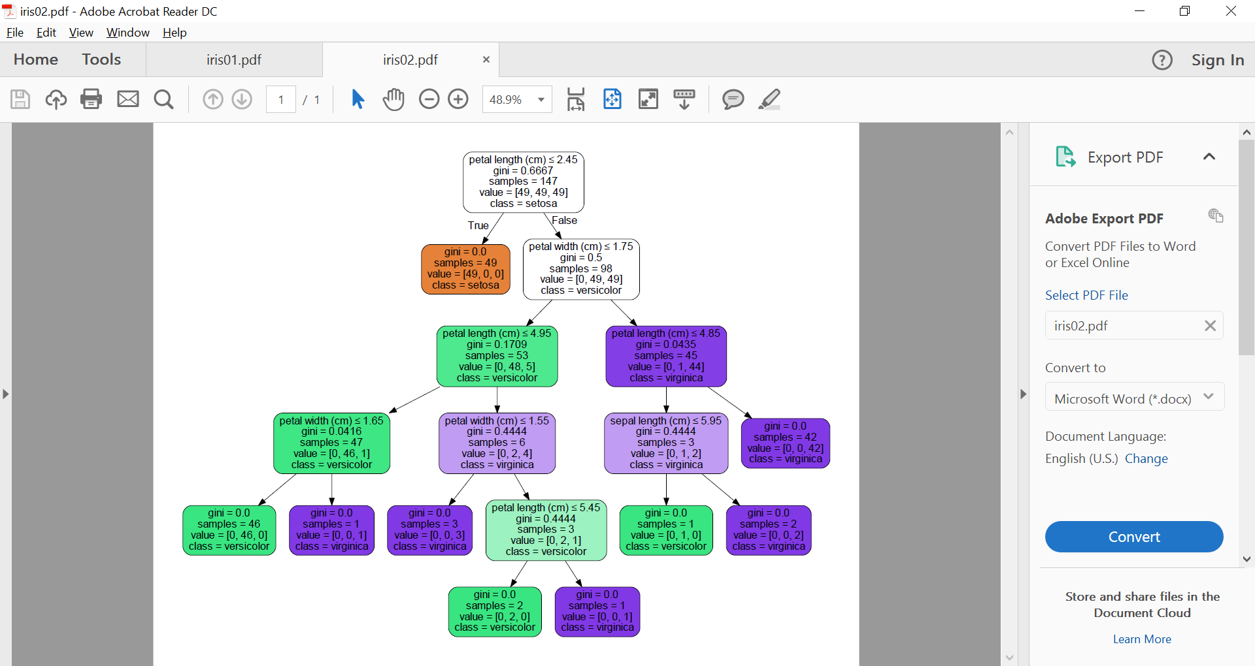
Defining a Hands on Project
The result: (PDF file)

Slide 40
Defining a Hands on Project
Goals
Import dataset
Train a classifier
Predict label for new flower(s)
Visualize the tree

Slide 41
Defining a Hands on Project
Let’s trace more in our decision tree:

Slide 42
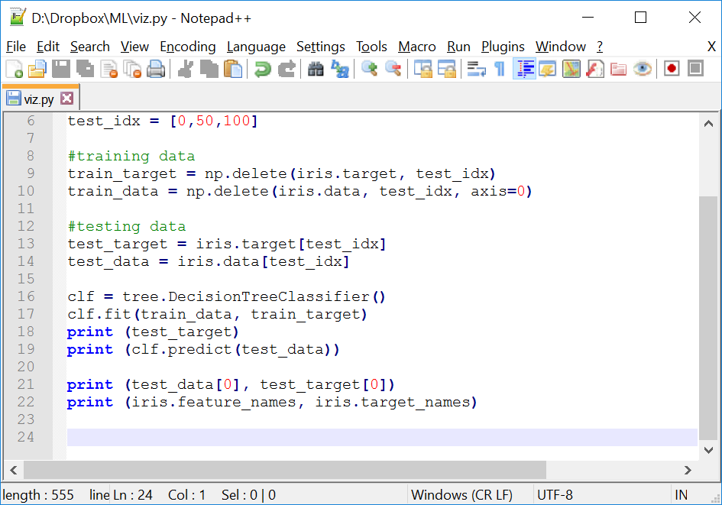
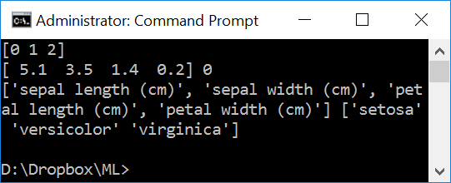
Defining a Hands on Project
Let’s check our first testing data:
Notes:
import numpy as np
from sklearn.datasets import load_iris
from sklearn import tree
iris = load_iris()
test_idx = [0,50,100]
#training data
train_target = np.delete(iris.target, test_idx)
train_data = np.delete(iris.data, test_idx, axis=0)
#testing data
test_target = iris.target[test_idx]
test_data = iris.data[test_idx]
clf = tree.DecisionTreeClassifier()
clf.fit(train_data, train_target)
print (test_target)
print (clf.predict(test_data))
print (test_data[0], test_target[0])
print (iris.feature_names, iris.target_names)

Slide 43
Defining a Hands on Project
Activity: Please try the same interval for the second testing data

Slide 44
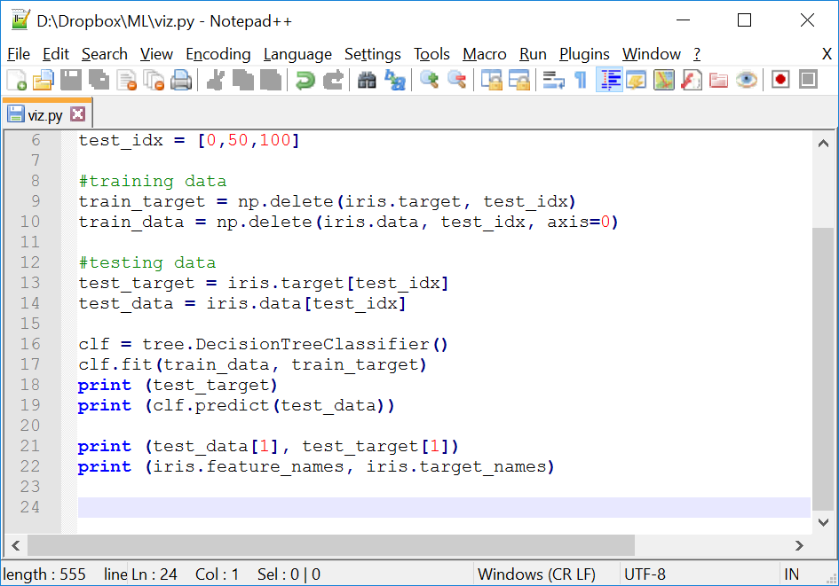
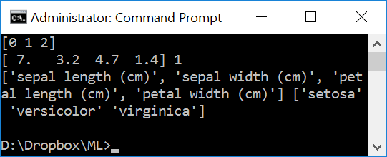
Defining a Hands on Project
Please discuss if you get any other respond. Can you elaborate on that?
Notes:
import numpy as np
from sklearn.datasets import load_iris
from sklearn import tree
iris = load_iris()
test_idx = [0,50,100]
#training data
train_target = np.delete(iris.target, test_idx)
train_data = np.delete(iris.data, test_idx, axis=0)
#testing data
test_target = iris.target[test_idx]
test_data = iris.data[test_idx]
clf = tree.DecisionTreeClassifier()
clf.fit(train_data, train_target)
print (test_target)
print (clf.predict(test_data))
print (test_data[1], test_target[1])
print (iris.feature_names, iris.target_names)

Slide 45
Defining a Hands on Project
Let’s trace it on the calculated decision tree:

Slide 46
Defining a Hands on Project
Let’s trace more in our decision tree:

Slide 47
More to Learn
How are trees built automatically from examples?
How well do they work in practice?

Slide 48
Conclusion
Every question the tree asks must be about one of the features. So choosing good features is one of your most important jobs.
The better your features are, the better a tree you can build.

Slide 49
Quote
"I am never afraid of the future of Artificial Intelligence (AI); all I am afraid of is the current status of artificial emotions."
~Reza

Slide 50
Thank you

Slide 51

Appendix:
Installing anaconda / packages / graphviz

Slide 52
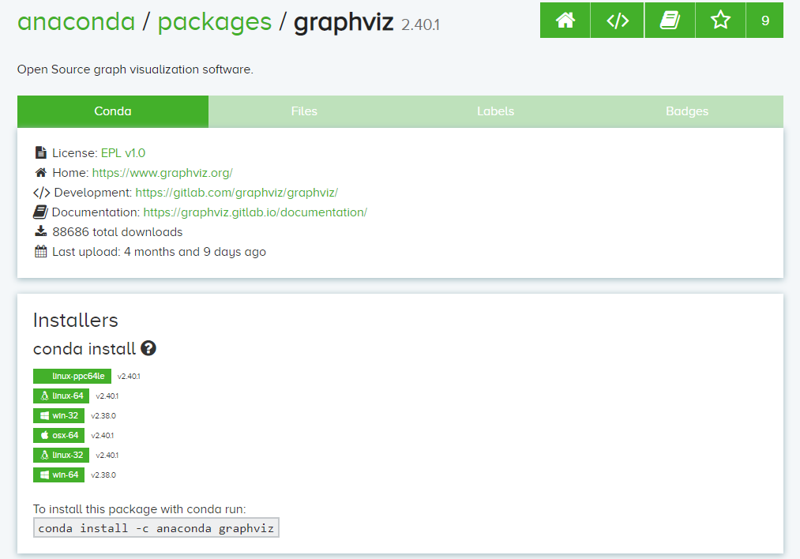
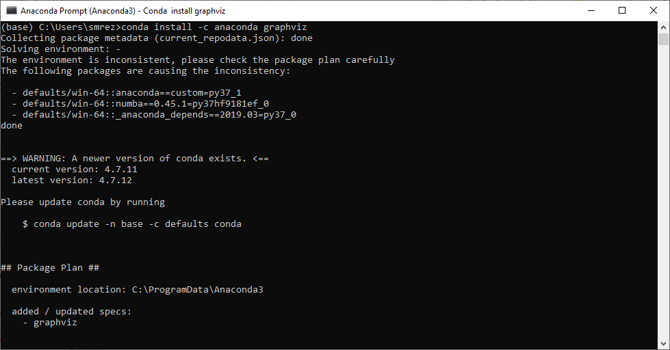
To install this package with conda
Notes:
https://anaconda.org/anaconda/graphviz
conda install -c anaconda graphviz

Slide 53
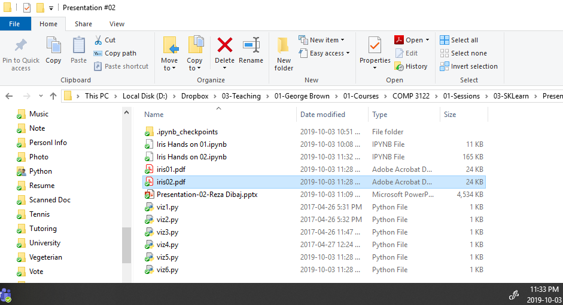
Result of the notepad file….

Slide 54
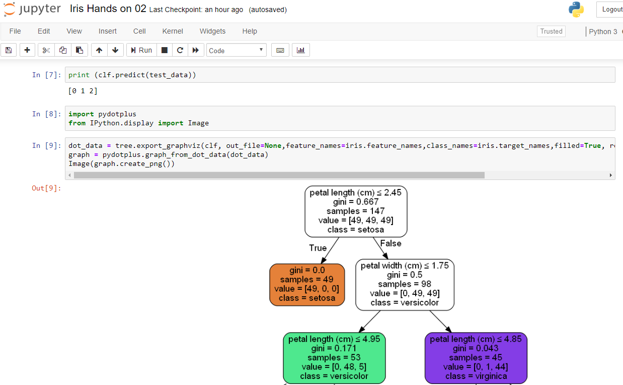
Result using the Jupyter Notebook

